Slide 1
Let’s Play War
Inside 4chan’s Competing Narrative Construction
Team Members: Phillip Stenmann Baun, Maximilian Schlüter, Daniel Bach, Janna Joceli Omena, Wade Keye, Sean Ward, Carina Westling, Yuening Li, Anunaya Rajhans, Grace Watson, Marco Valli, Beatrice Gobbo, Martin Trans
Notes:
Inside 4chan’s intergroup rivalry, contingent community formation, and fandomized war reporting

Slide 2
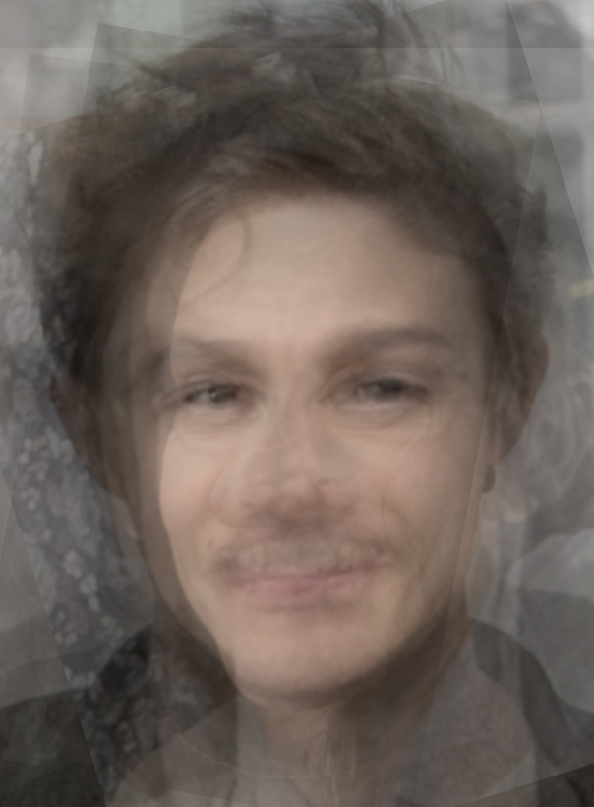
Team Members: Phillip Stenmann Baun, Maximilian Schlüter, Daniel Bach, Janna Joceli Omena, Wade Keye, Sean Ward, Carina Westling, Yuening Li, Anunaya Rajhans, Grace Watson, Marco Valli, Beatrice Gobbo, Martin Trans

Slide 3
Introduction
In week one, this project investigated two competing 4chan groups (/uhg/ and /chug/). The two threads fandomize the Ukrainian war through anthropomorphising and fictionalising nations and militaries in the form of memes.
There is a lack in the differential political positioning of the threads. Their sensemaking is antisemitic in nature. The differences are more stylistic than substantial.
Notes:
Two intro slides-one recap and one this week
More in bullet points

Slide 4
Main Goals
Main goals: Playing with visual methods and narrative analysis - rapid cycling between quantitative and qualitative approaches to optimise the interaction between methodological approaches.
Relevance: The domain limitations and affordances of digital and human methods, and approaches to leveraging both, further knowledge generation
Notes:
Two intro slides-one recap and one this week
More in bullet points

Slide 5
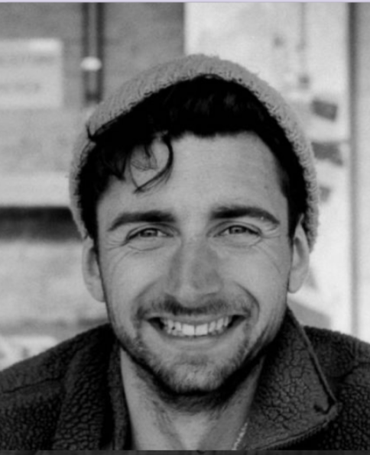
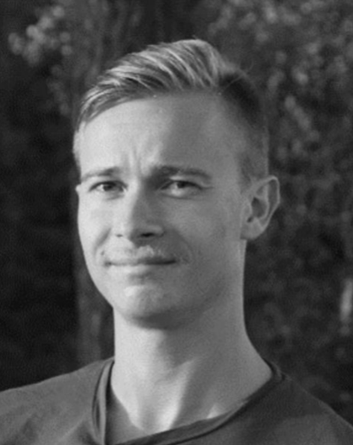

Slide 6
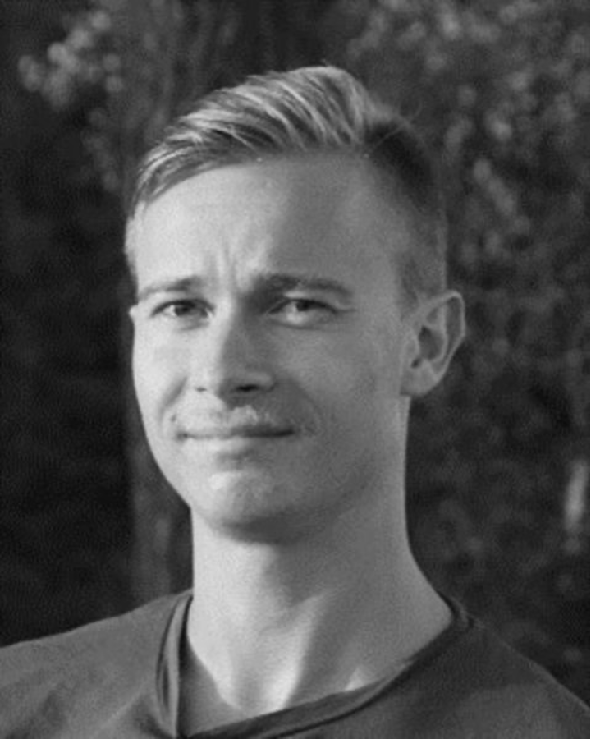

Slide 7
Global RQs
Three sub-groups formed around questions of territory and conflict:
RQ1: What can shared OP images tell us about inter-group rivalry and contingent community formation?
RQ2: How can the flag displays help us make sense of the embedding of national narratives in global, anonymous communities?
RQ3: How are sexualised images of women employed to narrate the Russo-Ukrainian war?

Slide 8
Global RQs
Three sub-groups formed around questions of territory and conflict:
RQ1: What can shared OP images tell us about inter-group rivalry and contingent community formation?
RQ2: How can the flag displays help us make sense of the embedding of national narratives in global, anonymous communities?
RQ3: How are sexualised images of women employed to narrate the Russo-Ukrainian war?

Slide 9
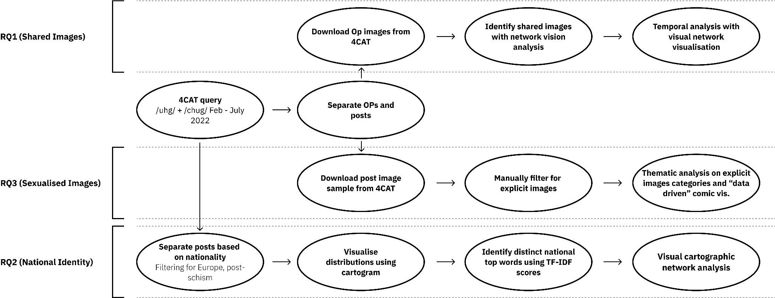

Slide 10
RQ1 (Shared Images) RQ2 (National Identity) RQ3 (Sexualised Images)
Download Op images from 4CAT
Identify shared images with network vision analysis
Temporal analysis with visual network visualisation
4CAT query
/uhg/ + /chug/ Feb - July 2022
Separate OPs and posts
Download post image sample from 4CAT
Manually filter for
explicit images
Thematic analysis on explicit images categories and “data driven” comic vis.
Separate posts based on nationality
Filtering for Europe, post-schism
Visualise distributions using cartogram
Identify distinct national top words using TF-IDF scores
Visual cartographic network analysis
Notes:
shared-images
Scrape 4chan with 4CAT to download all images of /chug/ and /uhg/ OPs images
Shared images detection through networks of OPs images and sites of image circulation (with Google Vision API)
Use Image Query and Extraction Tool to create a folder with the 36 shared images
A navigational procedure analysis with an interdisciplinary team (issue experts, digital methods researcher and communication designers) and a range of tools (ImageSorter, Google spreadsheets and slides, and archive.4plebs.org).
For the exploratory analysis, we also used a network visualisation - nodes as images and 4chan pols (chug and uhg), nodes positioning by timeline.
Manual coding images according to threads content. Four main categories were created (below) and specific cases pertaining to these categories such as shill and fake threads (), /tug/ and reactions to /chug/ and /uhg/ posts
Pro-uhg
Pro-chug
Non-aligned
Ambivalent
Annotate the slides and network. Examine the final visualisation for concluding the analysis.
Flags
Used previously scraped dataset of /UGH/ and /CHUG/ threads queried with 4CAT. Analysed distribution of nationalities (represented by flags) from both /UGH/ and /CHUG/ after February 27 (after the schism).
We chose countries from Europe and Caucasus, as well as Kazakhstan, as subjects of further enquiry due to their (potentially) disparate national narratives, as well as geopolitical stake in the conflict due to, among other factors, (potential) NATO memberships and assumed political (mal-)alignment with dominant western discourses
Did text analysis of flag data, using TF-IDF scores of top 20 words from posts from users from each European nation, comparing most distinct “country-specific words” of each European nation with all other nations.
Sexualisation
Queried 4CAT for 15,000 images from the UHG post dataset and CHUG post dataset, giving a total of 30,000 images.
Manually filtered each image set for sexualised content
Performed thematic analysis on the filtered sets by reading them in context of the threads
Put the set of explicit images through computer vision software [-> didn’t yield results as intended, and ended up telling us more about the Google Vision API instead, which was outside our scope]

Slide 11
RQ1 // Shared Images
RQ 1.1 Which images are used in the OP of both /uhg/ and /chug/?
RQ 1.2 What can shared images reveal about inter-group rivalry and is the method able to find traces of shilling*?
*shilling refers to a person engaged in covert advertising. The shill attempts to spread buzz by personally endorsing the product in public forums with the pretense of sincerity, when in fact he is being paid for his services. “Who are you shilling for?” [...] (Urban Dictionary)
**shilling can happen on multiple levels, we focus on the thread level
Notes:
What can shared images tell us about inter-group rivalry and contingent community formation?

Slide 12
RQ1 // Shared-images
RQ 1.1 Which images are used in the OP of both /uhg/ and /chug/?
RQ 1.2 What can shared images reveal about inter-group rivalry and is the method able to find traces of shilling*?
*shilling can happen on multiple levels, we focus on the thread level
*shilling refers to a person engaged in covert advertising. The shill attempts to spread buzz by personally endorsing the product in public forums with the pretense of sincerity, when in fact he is being paid for his services.
“Who are you shilling for?” [...] (Urban Dictionary)
Notes:
What can shared images tell us about inter-group rivalry and contingent community formation?

Slide 13
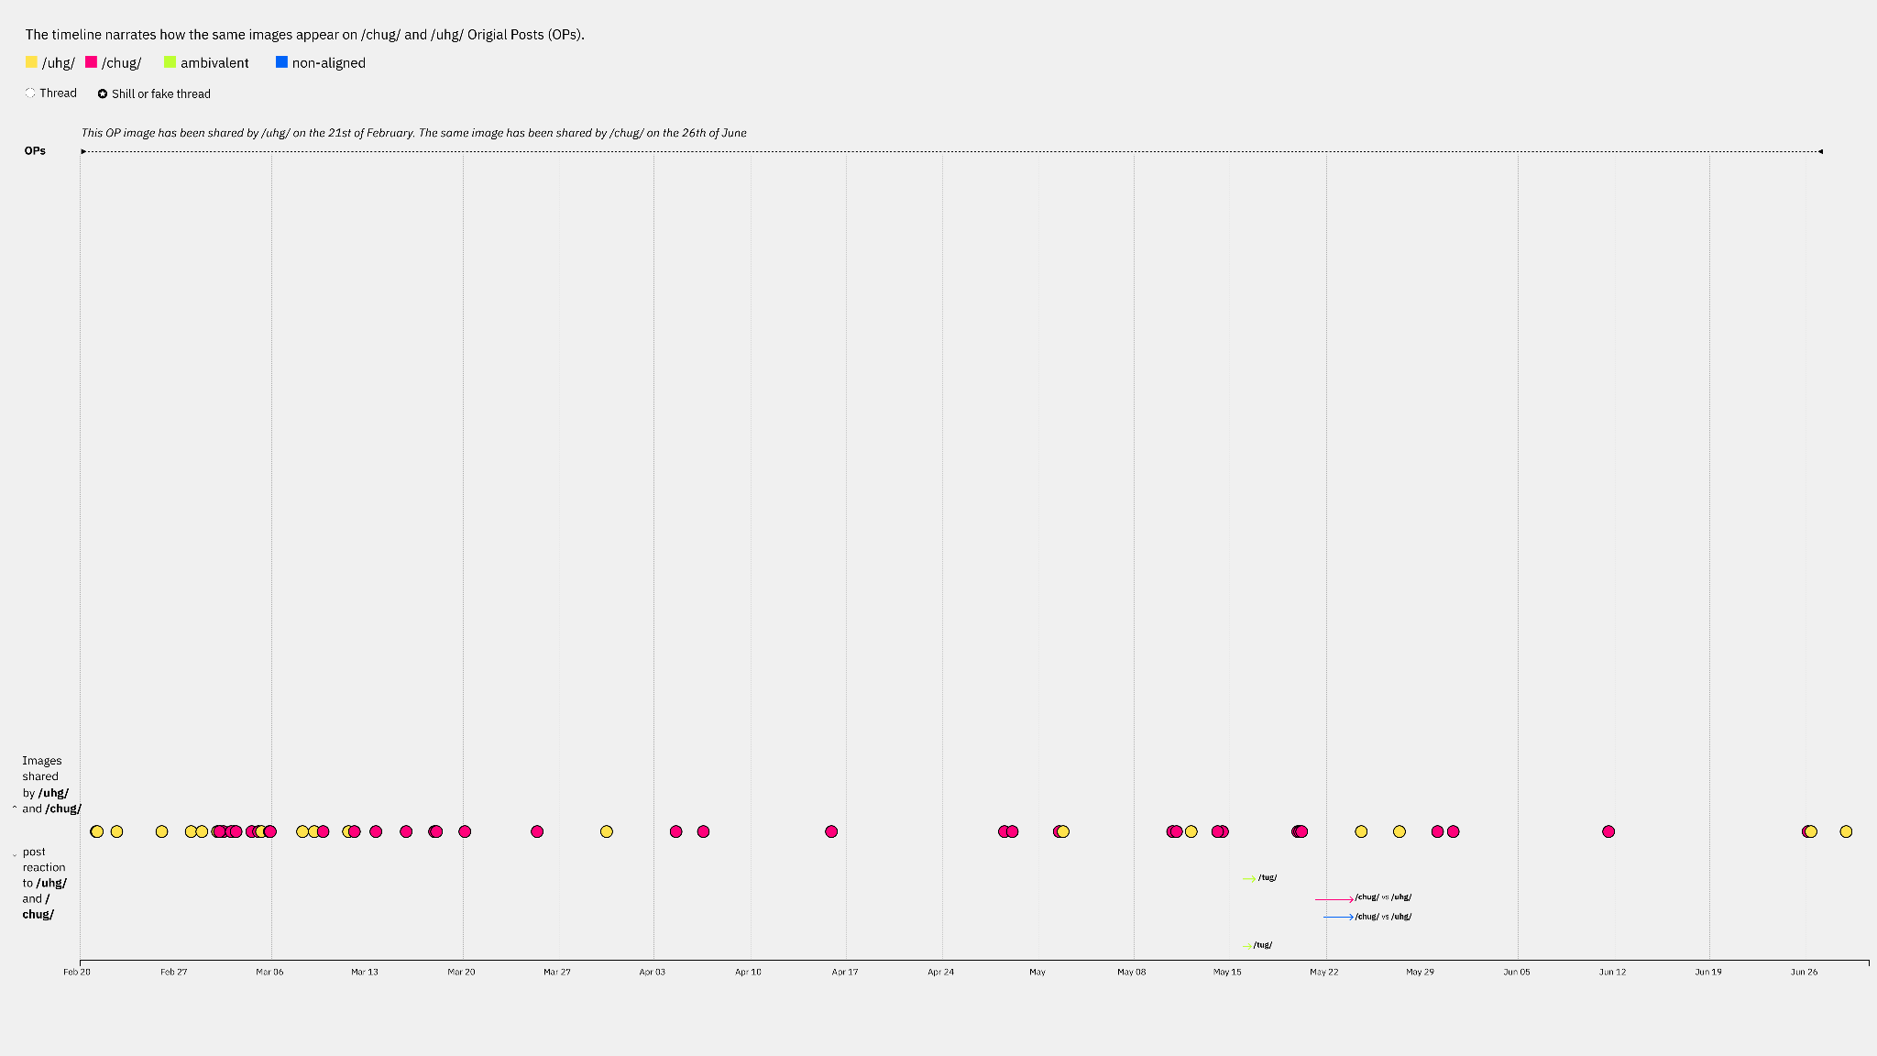
Notes:
Bottom line: yellow and red equals UHG or CHUG
Many images first appeared in UHG (before CHUG was born), then reposted on CHUG
Then after March its mostly CHUG images first, then reposted to UHG
Few images in general are shared (only 36 out of almost 6000 OPs images)
Comical Ali meme, first ironic the used literally (ambivalence) (show ambivalent images early in time, focus on Ali meme)
Reaction images are also ambivalent (focus on reaction images that are ambivalent)
Reaction images are found later in time (when UHG and CHUG have stabilized and the rest of pol are reacting to them)
TUG threads asking for help from UHG and CHUG (grassroots report → small anomaly of portuguese poster started compiling a “timeline” of the ukrainian war)
Both threads are creating shilling threads on the other’s (requires users to be vigilant to identity shills)
Method for cross platform analysis? Cross board analysis?

Slide 14
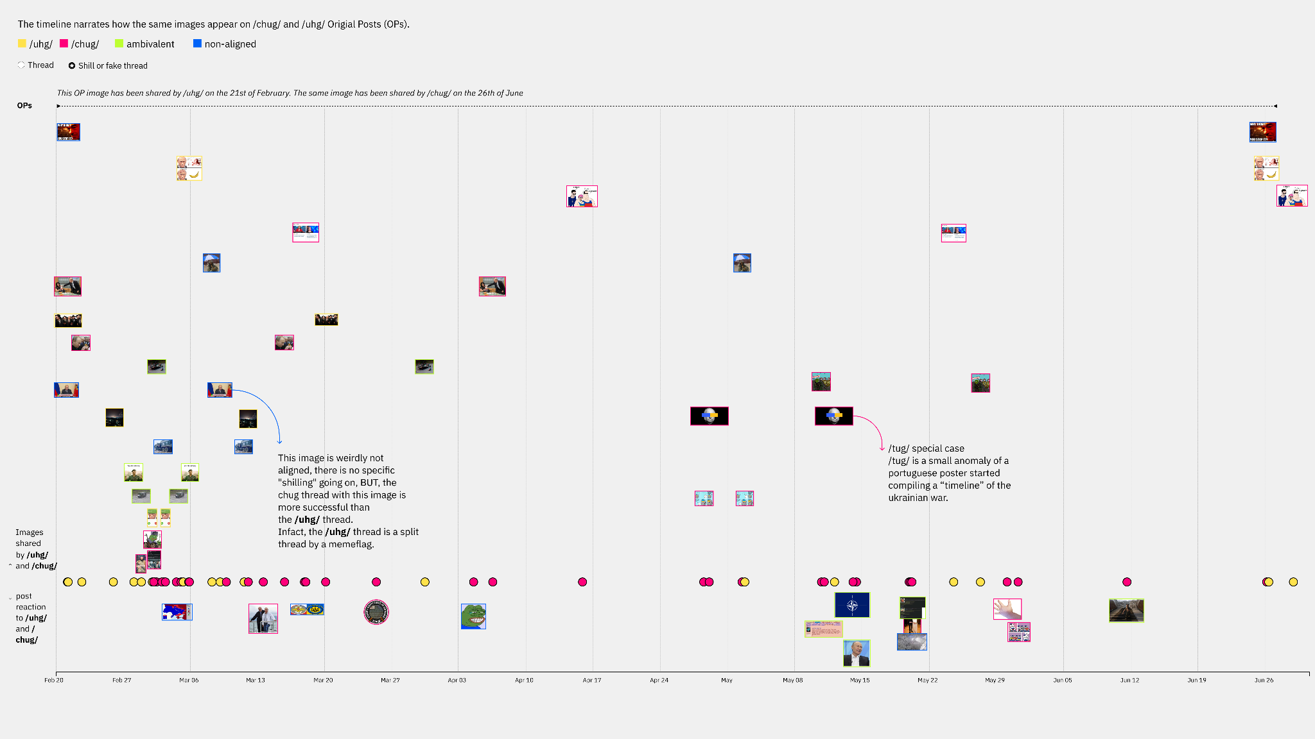
Notes:
Bottom line: yellow and red equals UHG or CHUG
Many images first appeared in UHG (before CHUG was born), then reposted on CHUG
Then after March its mostly CHUG images first, then reposted to UHG
Few images in general are shared (only 36 out of almost 6000 OPs images)
Comical Ali meme, first ironic the used literally (ambivalence) (show ambivalent images early in time, focus on Ali meme)
Reaction images are also ambivalent (focus on reaction images that are ambivalent)
Reaction images are found later in time (when UHG and CHUG have stabilized and the rest of pol are reacting to them)
TUG threads asking for help from UHG and CHUG (grassroots report → small anomaly of portuguese poster started compiling a “timeline” of the ukrainian war)
Both threads are creating shilling threads on the other’s (requires users to be vigilant to identity shills)
Method for cross platform analysis? Cross board analysis?

Slide 15
Notes:
Bottom line: yellow and red equals UHG or CHUG
Many images first appeared in UHG (before CHUG was born), then reposted on CHUG
Then after March its mostly CHUG images first, then reposted to UHG
Few images in general are shared (only 36 out of almost 6000 OPs images)
Comical Ali meme, first ironic the used literally (ambivalence) (show ambivalent images early in time, focus on Ali meme)
Reaction images are also ambivalent (focus on reaction images that are ambivalent)
Reaction images are found later in time (when UHG and CHUG have stabilized and the rest of pol are reacting to them)
TUG threads asking for help from UHG and CHUG (grassroots report → small anomaly of portuguese poster started compiling a “timeline” of the ukrainian war)
Both threads are creating shilling threads on the other’s (requires users to be vigilant to identity shills)
Method for cross platform analysis? Cross board analysis?

Slide 16
Results // Shared Images
Provides a methodological entryway into internal 4chan rivalry and shilling, reactions to contingent community formation and grassroots reportage.
Showing “anomalies” in the dataset (/tug/ & /wu/)
Notes:
What can shared images tell us about inter-group rivalry and contingent community formation?

Slide 17
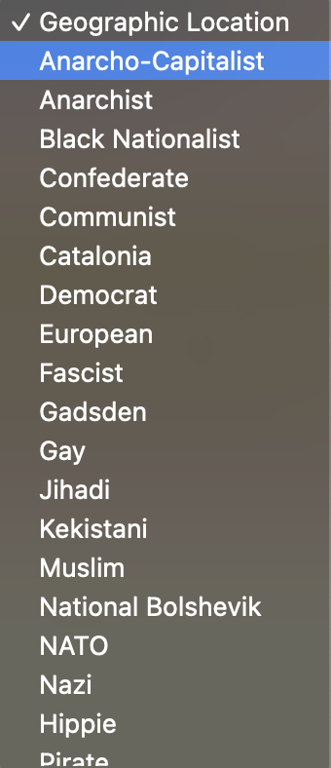
Results // Shared Images
National identities (flags) as identifier of shill threads and arbiter of meaning and truth
Notes:
What can shared images tell us about inter-group rivalry and contingent community formation?

Slide 18
RQ2 // Flags
RQ 2.1: What do flag displays tell us about the poster - do they align with particular political positions?
RQ 2.2: How important is national identity on a platform that defines itself by anonymity?
Notes:
What can shared images tell us about inter-group rivalry and contingent community formation?

Slide 19
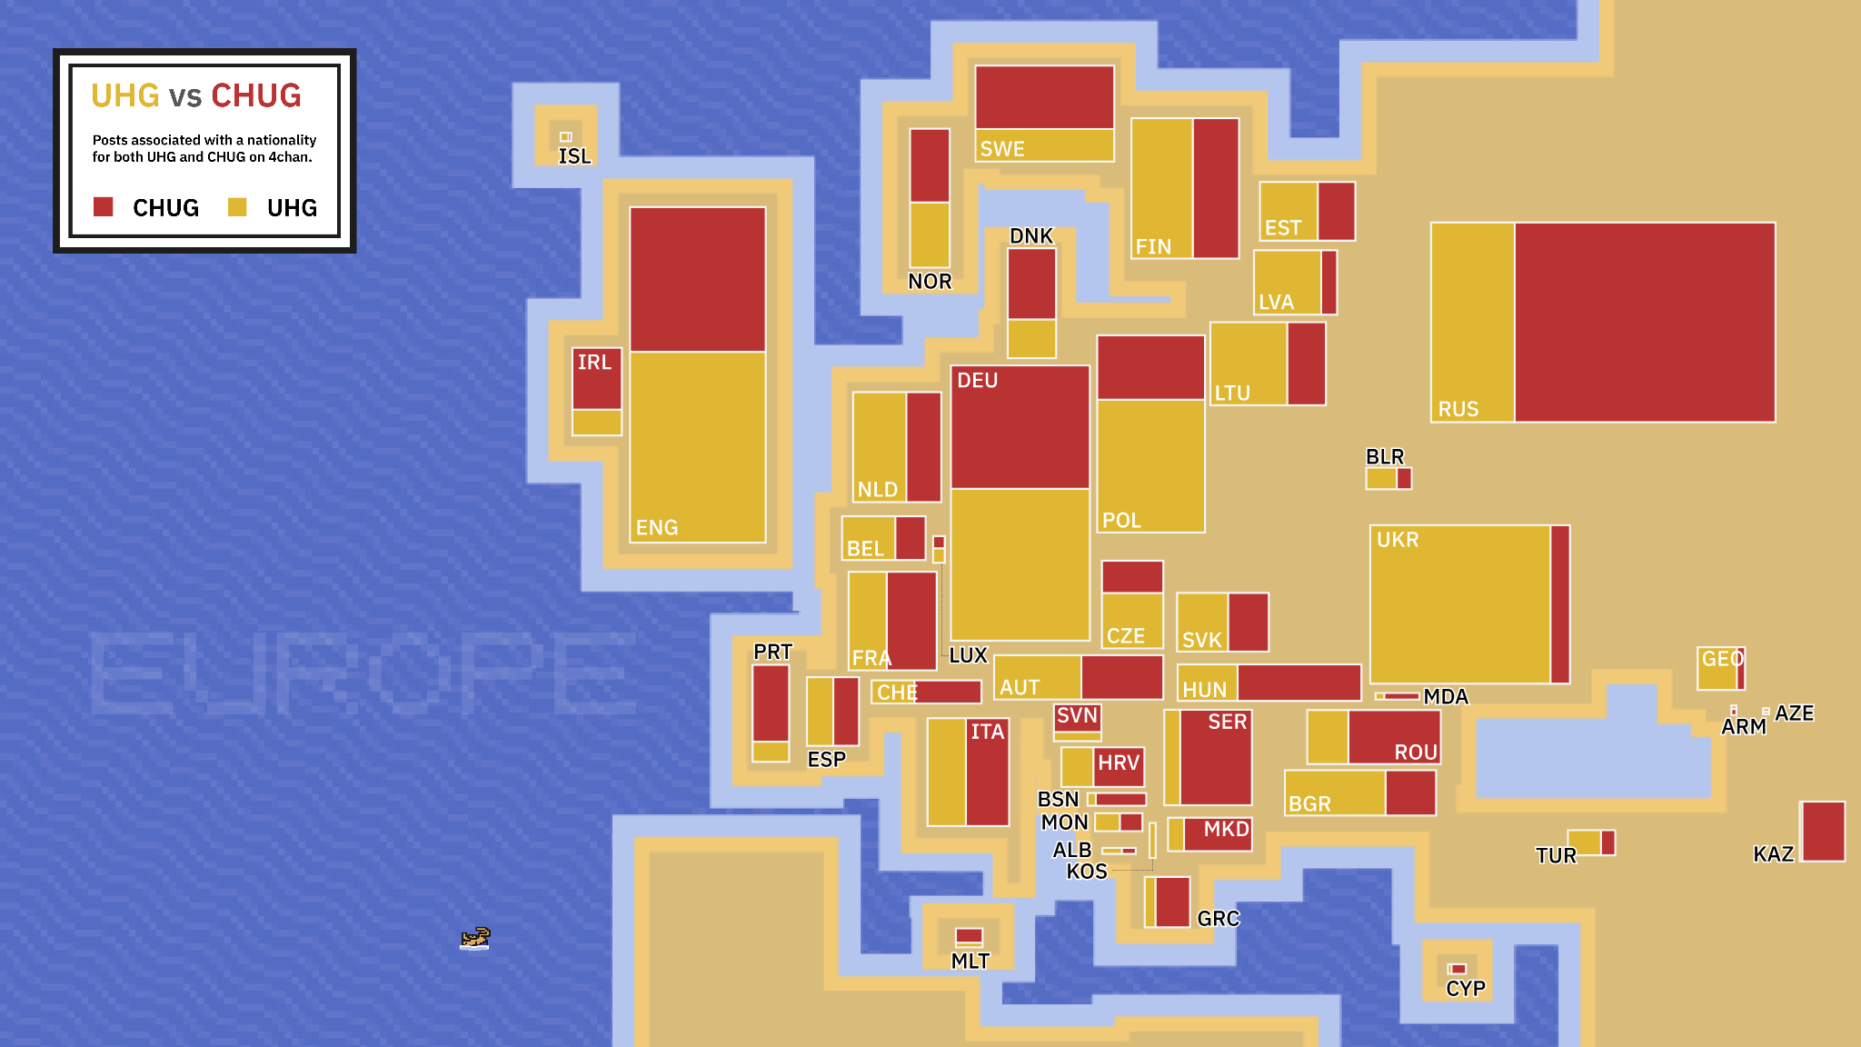
Notes:
Did text analysis of flag data, using TF-IDF scores of top 20 words from posts from users from each European nation, comparing most distinct “country-specific words” of each European nation with all other nations
Slightly contrary to the last image, while there may be national difference in thread preference, there appears to be a general concurrence of user’s discourse across nation borders (big circle in middle about Ukraine war)
Few country-specific keywords in general (discourse is shared across nations), although self-referencing does exist (users imputing own national interests into the general discourse)
Smaller countries have more unique keywords (methodological point)
NATO important for member countries, Sweden and Finland and also Serbia (different narratives), but curiously not by Russian or Ukrainian users
Hohol (derogatory term for Ukrainians) most prevalent from pro-Russian nations
Kazakh OSINT
Danish bakers

Slide 20
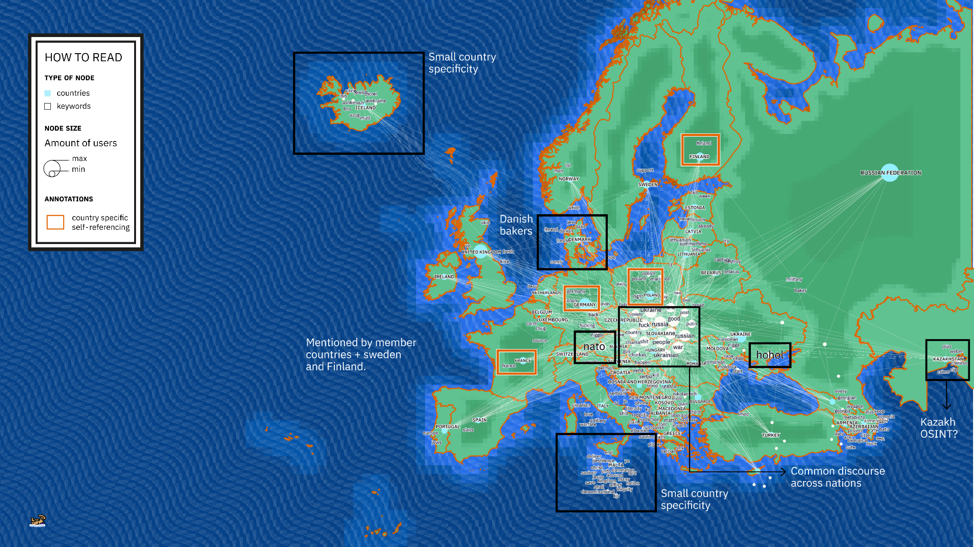
Notes:
Did text analysis of flag data, using TF-IDF scores of top 20 words from posts from users from each European nation, comparing most distinct “country-specific words” of each European nation with all other nations
Slightly contrary to the last image, while there may be national difference in thread preference, there appears to be a general concurrence of user’s discourse across nation borders (big circle in middle about Ukraine war)
Few country-specific keywords in general (discourse is shared across nations), although self-referencing does exist (users imputing own national interests into the general discourse)
Smaller countries have more unique keywords (methodological point)
NATO important for member countries, Sweden and Finland and also Serbia (different narratives), but curiously not by Russian or Ukrainian users
Hohol (derogatory term for Ukrainians) most prevalent from pro-Russian nations
Kazakh OSINT
Danish bakers

Slide 21
Results // Flags
Our findings identify the influence of proclaimed national identity within a community that cherishes anonymity, and showcase how nationalized narratives and sentiments become embedded in 4chan culture.
Notes:
What can shared images tell us about inter-group rivalry and contingent community formation?

Slide 22
RQ3 // Sexualised images of war
RQ 3.1: How do women become an agency to narrate the fandom construction of the Russo-Ukrainian War?
RQ 3.2: What is the symbolic meaning of sexual acts, and the lack of, in reporting different war positions of /chug/ and /uhg/?
RQ 3.3: What does the organisational practices behind the creation of the images tell us about the structures of /uhg/ and /chug/?
Notes:
What can shared images tell us about inter-group rivalry and contingent community formation?

Slide 23
Notes:
Can we replace this come before sexual to a full stop and start a new sentence there?

Slide 24
CHUG
Notes:
Full control of the war narrative I organisation (logos) I domination of female characters

Slide 25
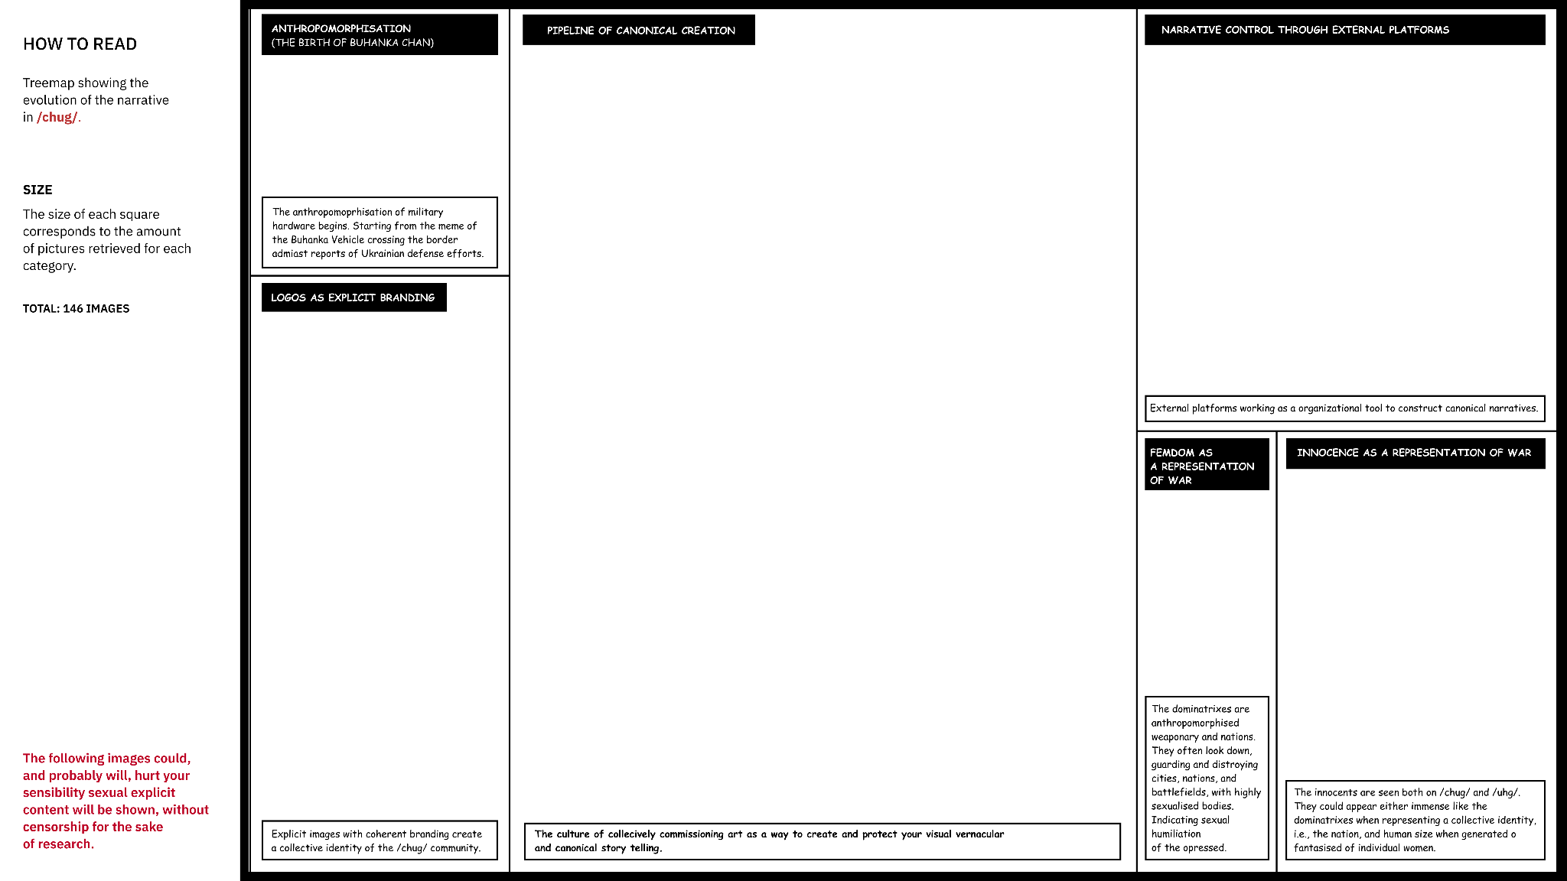
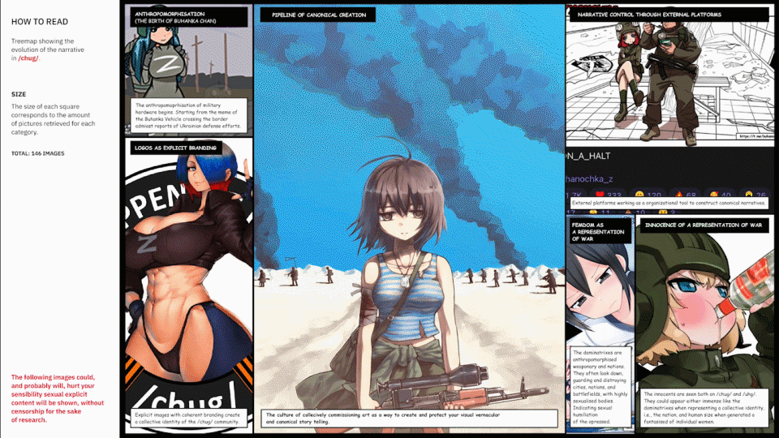
CHUG

Slide 26
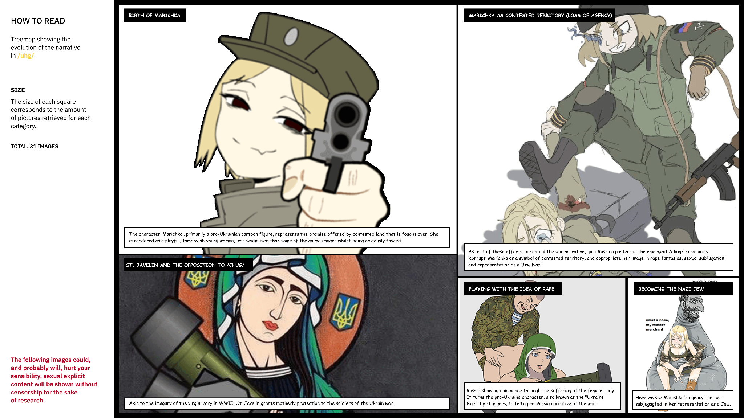
UHG

Slide 27
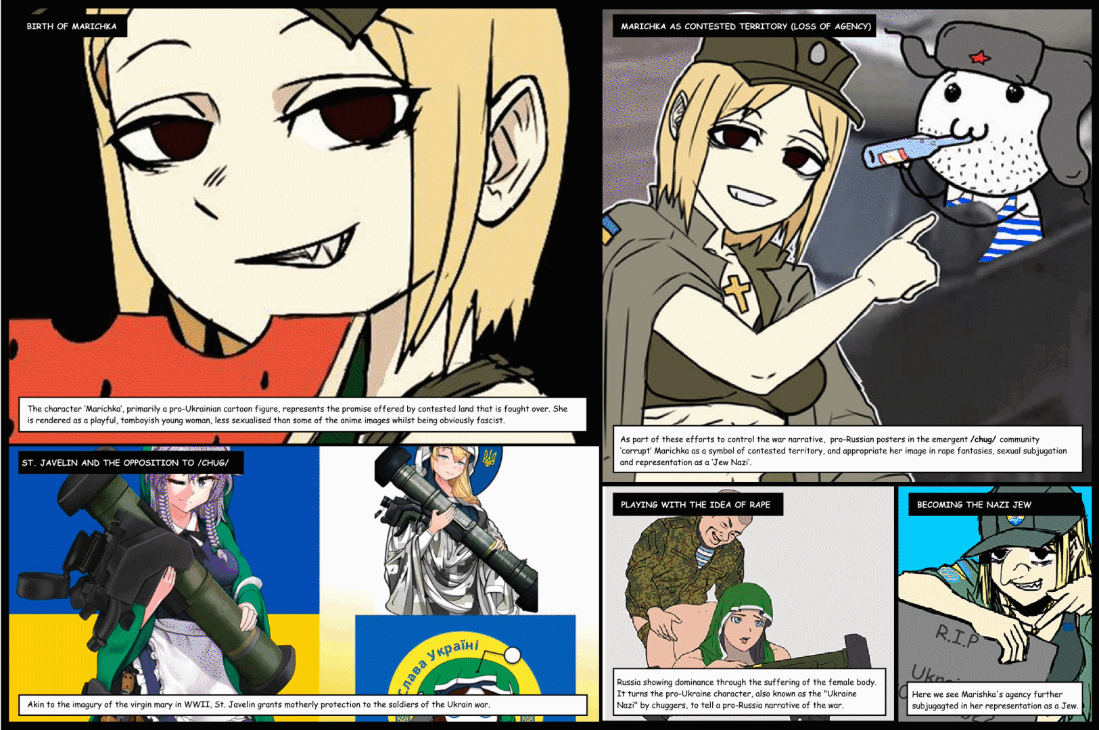
UHG

Slide 28
Results // Sexualised images of war
Result 1: The three variations of sexualised women, the dominatrices, the innocents, the ‘cuties’*..*Due to GDPR concerns and ethical implications of this research on explicit contents on 4chan, the cuties will not be addressed in this presentation.
Result 2: Although textual analysis last week found broad similarities in political positioning, image analysis reveals more distinction. Pro-Russian posts anthropomorphise weaponry and territory as anime girls, and the war as an act of sexual violence and humiliation.
Result 3: While there is a lack of visible masculinity displayed on neither /chug/ and /uhg/, the sexualised images of women are created wholly in a male gaze and support male fandomisation of the war.
Notes:
What can shared images tell us about inter-group rivalry and contingent community formation?

Slide 29
Conclusion
Rapid iteration of methodological approaches in a collaborative setting allowed us to combine the affordances of digital and human methods to ‘make sense’ of a large and intentionally confusing, even disorienting dataset.
Limitations
Image material size limitation
Ethical implications
Remixed images exceedingly hard to follow
Future research
Future paths should follow even more deeply 1) the friction between exogenous geographical-specific identities and endogenous de-territorialized community identities and 2) the organizational structures of /chug/ and the fidelity of their image vernacular.
Notes:
What can shared images tell us about inter-group rivalry and contingent community formation?

Slide 30
Main Takeaway
National and political identity being contested and defended
Flag jingoism and semiotic signalling
‘Woman-as-war terrain’
Notes:
Identity - national and political identity, in particular - is fiercely contested and defended in a forum that is based on anonymous participation. Flag jingoism falls within more or less traditional semiotic signalling, while antisemitism and a male-centric projection of ‘woman’ are floating signifiers and serve as effective containers for identity war play: the image of ‘the Jew’ allows players to vye for positions of political purity and the making and sharing of images of ‘woman-as-war terrain’ is a seemingly infinitely flexible and ‘therapeutic’ language of power, domination and submission in these communities.
To the 4chan ‘anti-normie brotherhood’, war fandoms seem to fulfil similar functions as sport fandoms do to others, although they do their best to hide normativity.

